Slide 1
RFID Mapping & Localization
PDR
Danielle Fuller, Aaron Gillespie, Matt Greenlee, Matt Hannon, Priya Mishra

Slide 2
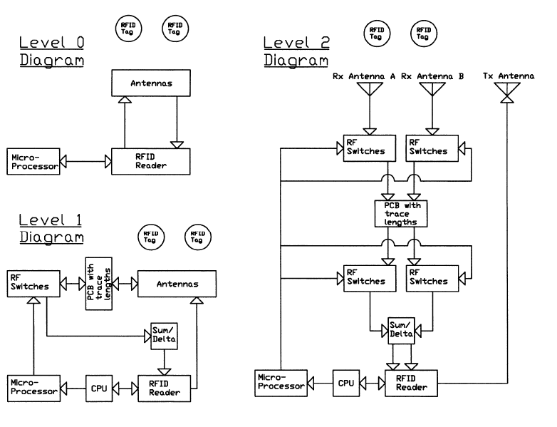
Functional Block Diagram

Slide 3
Functional Block Diagram

Slide 4
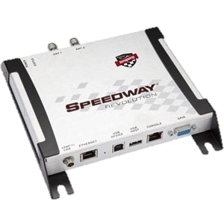
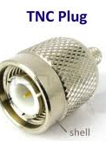
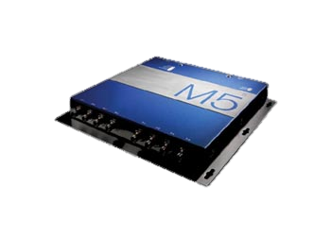
UHF Readers
Speedway Revolution by Impinj
Mercury5 by Thingmagic
Operating Frequency: 865 - 956 MHz
Low level reader protocol
Language: C++, C#
Access to: Phase, RSSI
Impinj RShell console
4 monostatic TNC ports
Price: ~$1,500
Operating Frequency: 902-928 MHz
Mercury API (Serial)
Language: C, RQL
Access to: Phase, RSSI
TX/RX Power level control
Up to 4 bistatic ports (TNC)
Price: ~$1,400

Slide 5
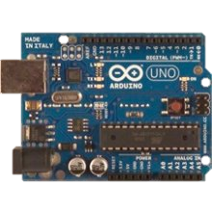
Microcontroller
Arduino Uno
Details:
Microcontroller: ATmega328
14 Digital I/O
Language: C and usage of open libraries
Purpose:
Interface with computer UHF reader application
Control RF switches

Slide 6
Feedback Network
UHF Reader
Computer
Arduino
RF Switches/ Beam Steering
Localizing Network
Components:
UHF Reader
Computer Application
Arduino
RF Switches controlling PCB trace lengths
Methods for Localization:
RSSI algorithm to help verify RF switching network results based on sum/delta network
Innovative power interrogation schemes to determine vicinity
Potential use of phase information for determining distance, velocity, and direction of tag

Slide 7
Functional Block Diagram
`

Slide 8
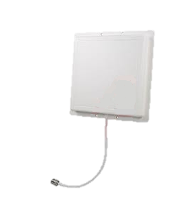
Antennas
Flat Patch Antennas by L-Com
Details:
Linearly polarized
Horizontal beam width: 75°
Vertical beam width: 65°
Size: 8.5” x 8.5”
Frequency: 900 MHz
Gain: 8 dBi
Weight: .45 kg
Price: $44.99 [ x3 = $134.97]
Connections:
Coaxial connection to UHF reader (Tx)
Coaxial connection to switches (Rx)

Slide 9
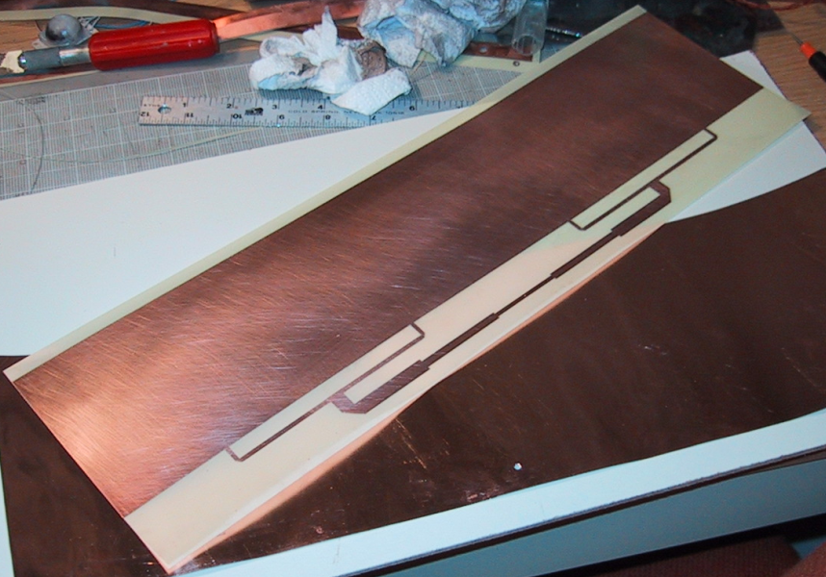
Homemade Patch Antenna (Backup Plan)
Pros:
Cost significantly less
Greater margin for error
Cons:
Look less professional
Large amount of research and trial/error needed
Reasons for COTS:
Learning curve too steep
Want client to be able to duplicate product independently

Slide 10
Functional Block Diagram
`

Slide 11
Localization (2-Element Array)
Direction from Reader:
Goal: accurate within 15°
Use of three LEDs to show direction from current location
Accomplished using steering network (steering the null)
Distance from Reader:
Goal: accurate within 3 feet
Will read up to 6 meters away
Accomplished using RSSI information from reader and triangulation

Slide 12
Determining Distance
Separation distance between antennas is known (~0.75λ)
RSSI is related to distance—strength is weaker from further distances, stronger when closer
Use two known values to triangulate tag
Will require testing and calibration to verify read distance is accurate
May not be possible since sum (+) signal is fed to reader, not the signals from receiving antennas
Could use dynamic power altering as backup—cut power in half, and if signal disappears you know the tag is between the limit and the half-way mark
RFID tag
d _{left} _{strength}
d _{right} _{strength}
D _{tag}
antenna left
antenna right
d _{separation}

Slide 13
Determining Direction
Steer null for more precise resolution (vs. wide beam width)
Use RSSI (Received Signal Strength Information) to verify phase information (phase says to left, RSSI should be stronger for left antenna)
Hybrid coupler: two inputs (antennas), two outputs (+/Δ)
If Δ is positive, tag is right of null
If Δ is negative, tag is left of null
If Δ is zero, tag is in line with null
We currently can’t find a device that does this—alternate method is use of a summing network (summing amplifier?) for + and a 180° phase-shift of one antenna for Δ
Advantages: Adding one trace would be simple; low cost, low real estate
Disadvantages: Need another RF switch (~$125); summer is noisy

Slide 14
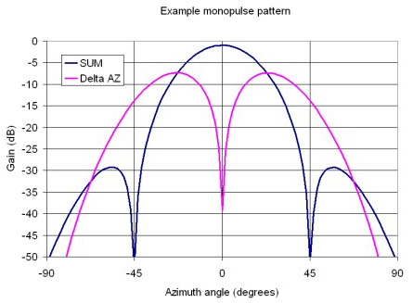
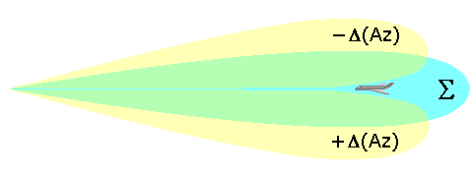
Null Steering

Slide 15
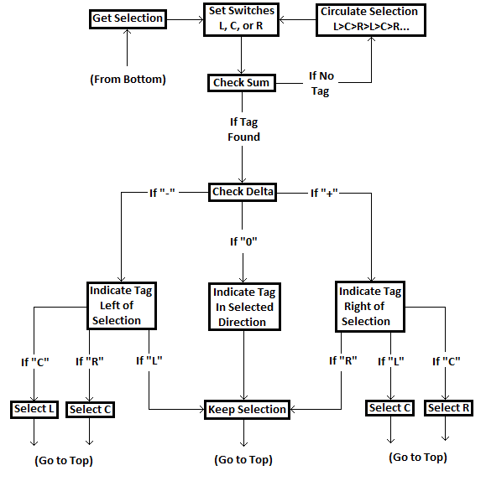
Switching Software Flow Chart

Slide 16
Costs
[Honeywell budget is not set in stone—reader purchase has been approved, but other funding has yet to be decided.]

Slide 17
Schedule

Slide 18
Testing
UHF Reader:
Connect an antenna directly to the reader and locate a known tag, comparing results with known parameters
Antennas:
Hook up antennas to a spectrum analyzer to confirm patterns/strength
Steering:
Test traces by hooking to network analyzer to verify the correct phase shift occurs for each length; Still TBD for testing switches
Localizing:
Feed in known input signals from a function generator and verify appropriate output signals on an oscilloscope
Overall system:
Hook everything together, point at tag with known ID, distance and direction, compare results with actual values

Slide 19
Risk Mitigation
UHF Reader:
Access to phase information not accessible → Use RSSI and algorithm to determine direction
Reader can’t process sum/difference signals simultaneously → Do phase comparison externally before the reader by going straight to Arduino
Unable to get the sum/difference unit to function → Use a summer and 180° phase shifting traces and two more switches
Antennas:
Receiver beam widths of 65° reduce accuracy → Rework steering network with (possibly) more traces to fine-tune
Steering:
Desired phase shifts not achieved with PCB traces → Use a phase-shifting IC
Can’t get funding for evaluation boards → Design own circuitry
Localizing:
Reader won’t read tags because of a malfunction → Call company, get money back, and spend remainder of project on design of subsections and a theoretical complete system

